Slide 1

A Seminar Presentation on
EMISSION OF FLUE GASES IN THERMAL POWWR PLANT
Madan Mohan Malaviya University of Technology, Gorakhpur
Represented by:-
SHIVAM
(Roll no:2023051069)
Mechanical Engineering Department
Madan Mohan Malaviya University of Technology
*

Slide 2
Madan Mohan Malaviya Univ. of Technology, Gorakhpur
CONTENTS
  Introduction
  Thermal Power Plant Overview
  Emission Sources
  Environmental Impact of SOx and NOx
  Emission Measurement Technique
  SOx Control Technique
  NOx Control Technique
  Case Study Of Thermal Power Plant
  Conclusion
  References
*

Slide 3
Madan Mohan Malaviya Univ. of Technology, Gorakhpur
1. Introduction
. Thermal power plants are one of the main sources of electricity generation worldwide,
especially in developing countries. They operate by burning fossil fuels such as coal, which
leads to the production of large volumes of flue gases. [1]
.
These flue gases contain harmful pollutants like carbon dioxide (CO₂), sulfur dioxide
(SO₂), nitrogen oxides (NOₓ), and particulate matter. If released untreated, they cause
air pollution, climate change, acid rain, and serious health hazards.
.
Therefore, controlling flue gas emissions has become an important environmental and
regulatory requirement. Various prevention and control technologies are adopted in thermal
power plants to reduce pollution and ensure sustainable power generation. [3]
*

Slide 4
Madan Mohan Malaviya Univ. of Technology, Gorakhpur
2. THERMAL POWER PLANT OVERVIEW
CORE COMPONENTS:-
A thermal power plant operates by burning coal to generate electricity. The process begins with coal pulverization, followed by combustion in a boiler to produce high-pressure steam. This steam drives a turbine, which is connected to a generator that produces electricity. [1]
OPERATIONAL CYCLE:-
The exhaust steam from the turbine is then cooled in a condenser, turning it back into water to restart the cycle. This continuous process ensures efficient electricity generation.
There are some boilers present there .
These advanced boilers operate at extremely high temperatures and pressures, further enhancing the plant's overall performance and reducing fuel consumption per unit of electricity generated. [2]
*

Slide 5
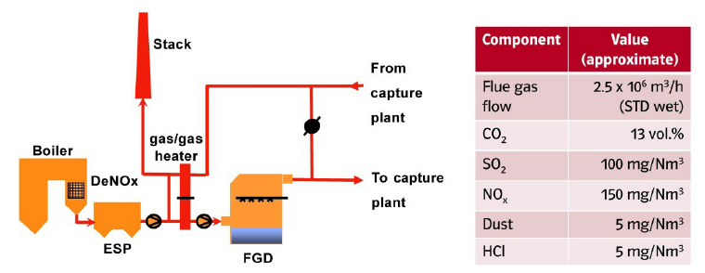
Madan Mohan Malaviya Univ. of Technology, Gorakhpur
3. EMISSION SOURCES IN THER. PLANT
COAL COMBUSTION :-
The primary source of emissions is the combustion of coal. This process converts the chemical energy stored in coal into thermal energy, but it also releases various pollutants into the atmosphere, including sulfur and nitrogen compounds.[1]
. FLUE GAS :-
Flue gases are the byproduct of coal combustion and contain harmful pollutants. These gases are discharged through the plant's stacks after passing through various treatment systems. Key pollutants include sulfur dioxide (SOx) and nitrogen oxides (NOx), which are major contributors to air pollution. [2]
Fig(1) flue gases emission
*

Slide 6
Madan Mohan Malaviya Univ. of Technology, Gorakhpur
. PARTICULATE MATTER :-
Thermal power plants also emit particulate matter,
which consists of fine airborne particles. These particles can vary in size and composition,
ranging from ash to unburnt carbon. While modern plants use electrostatic precipitators or
baghouses to capture most of these, some finer particles can still escape.[2]
.
TRACE METALS :-
Beyond the main pollutants, coal combustion also releases trace metals such as mercury,
arsenic, and lead. These heavy metals, present in small quantities in coal, can have significant
environmental and health impacts if not properly controlled and removed from the flue gas
stream.[1] [2]

Slide 7
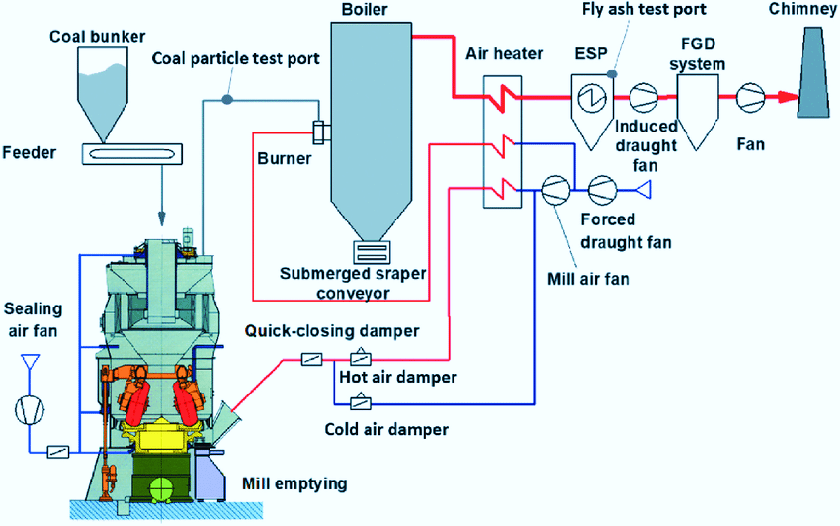
Madan Mohan Malaviya Univ. of Technology, Gorakhpur
fig(2) flow of flue gases [1] [7]

Slide 8
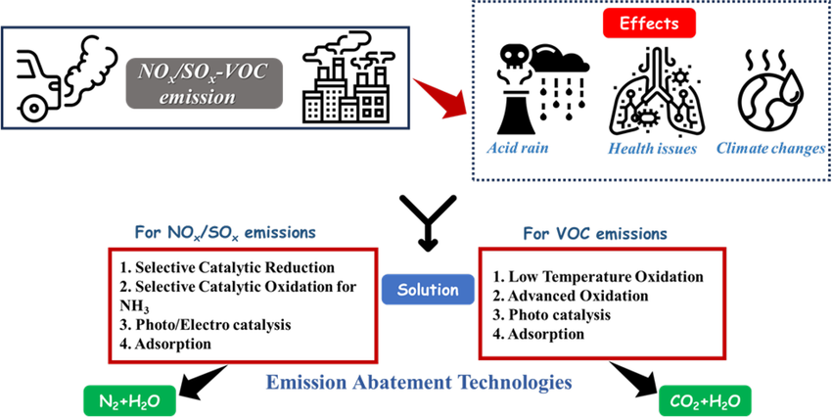
Madan Mohan Malaviya Univ. of Technology, Gorakhpur
4. ENVIRONMENTAL IMPACT OF SOx and Nox
• Acid rain
• Air pollution
• Vegetation damage
• Health hazards
• Climate change
Fig(3) environmental impact of sox and nox [4] [5]

Slide 9
Madan Mohan Malaviya Univ. of Technology, Gorakhpur
5. EMISSION MEASURMENT TECHNIQUE
•
Continuous Emission Monitoring Systems (CEMS) :-)
CEMS provide real-time data on pollutant concentrations in flue gas. These systems ensure constant compliance with regulatory limits by continuously measuring SOx, NOx, carbon monoxide, and particulate matter using various analytical techniques, including gas analyzers and optical methods for dust. [3]
. Portable Analysers :-.
Portable analyzers offer flexibility for spot checks and troubleshooting in various plant locations. They provide immediate, on-site readings, making them invaluable for quick assessments and identifying emission issues before they escalate. While not as precise as CEMS, they offer convenience and rapid data. [5]
:-
•
Laboratory Analysis
For precise and detailed pollutant composition, samples are collected from stacks and transported to a laboratory. Advanced analytical instruments, such as gas chromatographs and mass spectrometers, are employed to determine the exact concentration and chemical makeup of various pollutants, providing highly accurate data for research and compliance verification. [5]

Slide 10
Madan Mohan Malaviya Univ. of Technology, Gorakhpur
6. SOx CONTROL TECHNIQUE
Integrated FGD System :-
At the thermal Power plant, the Flue Gas Desulphurisation (FGD) system was meticulously integrated into the plant's design from its inception. This proactive approach ensures seamless operation and maximum efficiency in SOx removal, making it a critical component their environmental control strategy. [1]
Absorber Tower Design :-
The absorber tower, a central component of the FGD system, is engineered to optimize the contact between the flue gas and the limestone slurry. Its advanced design facilitates efficient chemical reactions, converting SOx into gypsum and effectively capturing pollutants before they are released into the atmosphere. [6]
*

Slide 11
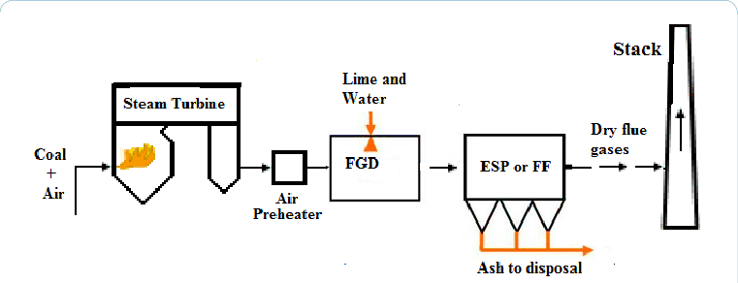
Madan Mohan Malaviya Univ. of Technology, Gorakhpur
FGD SYSTEM COMPONENTS AND WORKING PROCESS :-
fig(4) component of FGD system [1] [7]
(1) FLUE GAS INLET
(2) ABSORBER TOWER (SCRUBBER)
(3) CHEMICAL REACTION
CaCO₃ + SO₂ + ½ O₂ + 2H₂O → CaSO₄·2H₂O (Gypsum)
(4) DEMISTER SECTION
(5) SLURRY RECIRCULATION BLEED
CLEAN FLUE GAS EXIT [2]
*

Slide 12
Madan Mohan Malaviya Univ. of Technology, Gorakhpur
7. NOx CONTROL TECHNIQUES
Component | Description
Ammonia Storage and Injection System | Stores aqueous ammonia or urea solution and injects it into the flue gas stream.
Ammonia Vaporizer & Mixing Unit | Converts liquid ammonia into vapor and mixes it uniformly with flue gas.
Catalytic Reactor Housing | Contains catalyst modules arranged in layers (typically vanadium-based). This is where the chemical reduction of NOx happens.
NOx Sensors (CEMS) | Monitors inlet and outlet NOx concentration to optimize injection rate and ensure regulatory compliance.
Control System (DCS/PLC) | Fully automated system that regulates ammonia injection, flue gas flow, and catalyst temperature.
Air Preheater & Economizer Bypass (if needed) | Maintains flue gas temperature within the optimal range (300–400°C) for catalytic activity [4] [5]
*

Slide 13
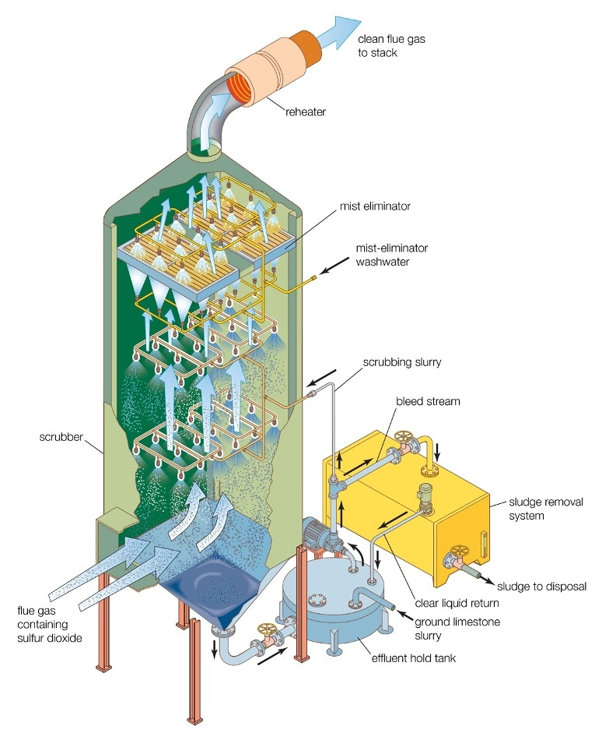
Madan Mohan Malaviya Univ. of Technology, Gorakhpur
Fig(5)Wet scrubber using a limestone slurry to remove sulfur dioxide from flue gas. [1]

Slide 14
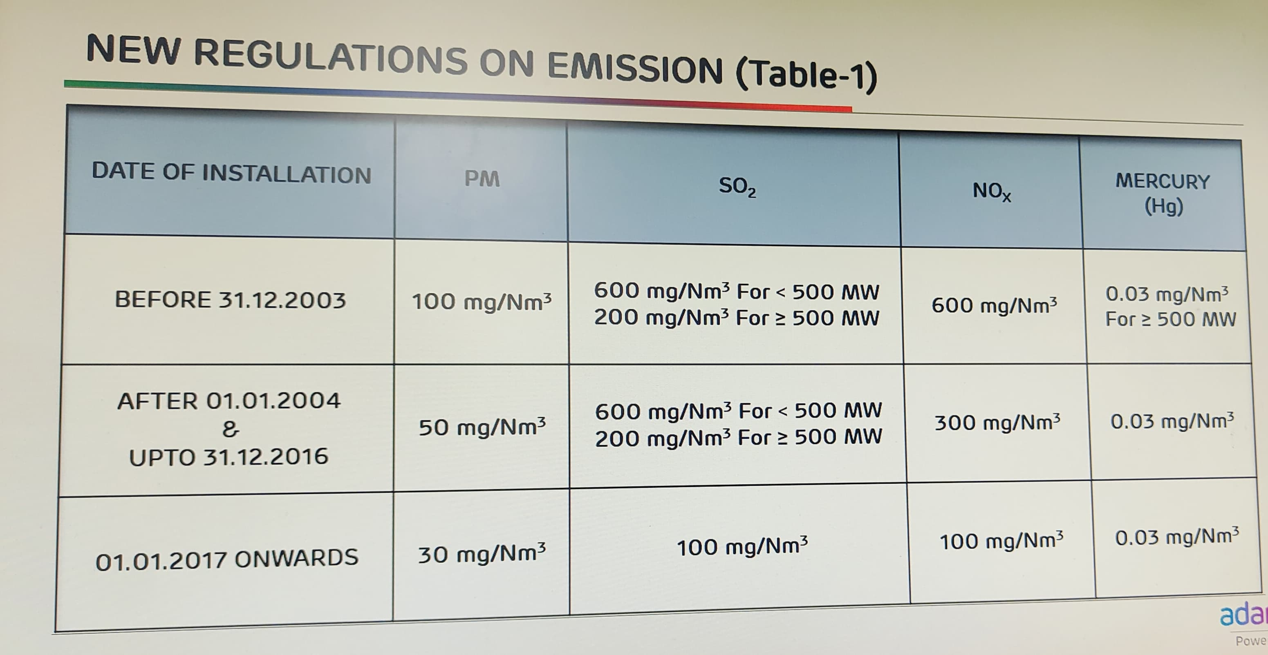
Madan Mohan Malaviya Univ. of Technology, Gorakhpur
GOVERNMENT REGULATIONS FOR Sox and Nox EMISSIONS [3] [4]

Slide 15
Madan Mohan Malaviya Univ. of Technology, Gorakhpur
8. CONCLUSION
This report has detailed the critical need for robust emission control in thermal power plants, focusing on SOx and NOx. The case study of thermal power plant exemplifies successful implementation of advanced Flue Gas Desulphurisation (FGD) technologies, demonstrating their efficiency in meeting stringent environmental standards. [6]
Key Takeaways:-
  (1) Thermal plants are major sources of SOx and NOx emissions.
(2) These emissions significantly impact public health and ecosystems
(3) Advanced control technologies like FGD are highly effective in
(4) Continuous monitoring and innovative solutions are crucial for compliance
.
Recommendations :-
(1) Invest in next-generation emission control technologies.
(2) Promote research into carbon capture and utilization (CCU).
(3) Strengthen international collaborations for technology transfer.
(4) Implement stricter regulatory frameworks and enforcement
*

Slide 16
Madan Mohan Malaviya Univ. of Technology, Gorakhpur
9. References:-
Nag, P. K.
Power Plant Engineering. Tata McGraw-Hill Education, New Delhi, India, 2014.
→ Used for thermal power plant layout, boiler process, flue gas generation, ESP, and air pollution control methods.
(2) Rajput, R. K.
Thermal Engineering. Laxmi Publications, New Delhi, India, 2013.
→ Used for coal combustion, emission sources, SOx and NOx formation, and control techniques.
(3) Central Pollution Control Board (CPCB), India.
“Emission Standards for Thermal Power Plants.” Ministry of Environment, Forest and Climate Change, Government of India.
Retrieved from: https://cpcb.nic.in
→ Used for emission limits, monitoring techniques, and regulatory norms.
(4) Ministry of Environment, Forest and Climate Change (MoEFCC), India.
“Environmental (Protection) Amendment Rules for Thermal Power Plants.” Government of India, 2015.
Retrieved from: https://moef.gov.in
→ Used for SO₂, NOₓ, and particulate matter emission regulations.
*

Slide 17
Madan Mohan Malaviya Univ. of Technology, Gorakhpur
(5) U.S. Environmental Protection Agency (EPA).
“Air Pollution Control Technology Fact Sheet – Flue Gas Desulfurization (FGD).”
Retrieved from: https://www.epa.gov
→ Used for FGD system working, absorber tower, and SOx removal process.
(6) International Energy Agency (IEA).
Emission Reduction Technologies for Fossil Fuel Power Generation.
Retrieved from: https://www.iea.org
→ Used for advanced emission control technologies and global practices.
(7) Babcock & Wilcox.
Steam Power Generation and Environmental Control Systems.
→ Used for ESP, FGD system components, and flue gas flow diagrams.

Slide 18

Madan Mohan Malaviya Univ. of Technology, Gorakhpur
*

